Slide 1
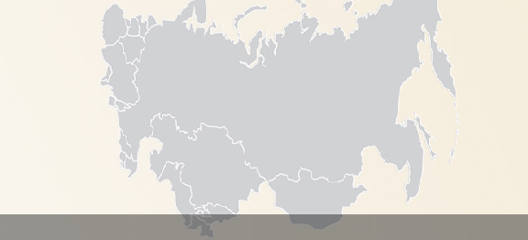
Community Advisory Board in Eastern Europe and Central Asia
Advocacy. Mobilization. Education

Slide 2
WHO
Treatment access activists
14 countries (Azerbaijan, Armenia, Belarus, Georgia, Estonia, Kazakhstan, Kyrgyzstan, Moldova, Latvia, Lithuania, Tajikistan, Uzbekistan, Ukraine)

Slide 3
The Region
Low treatment coverage
Low testing among vulnerable groups
Mostly IDU-driven
Difficult regulatory, economic and political landscape

Slide 4
Regional Dialogue
Make pharma pay attention to the region
Many voices louder than one
Dealing with the language barrier
Make the local offices listen to the local community

Slide 5
WHY
Bring together
activism and expertise
to improve access to treatment

Slide 6
Brief History
October 2011, St. Petersburg. HIV. ViiV, Abbot
June 2012, Tbilisi. HCV. Abbot, Janssen, Merck
February 2013, Kyiv. HIV. ViiV, MPP.
May 2013. St. Petersburg. HIV/HCV/TB. Janssen, Pharmasyntez, Gi(lead)
October 2013. Kyiv. HIV/HCV. Gilead, MPP.

Slide 7
Other activities
Trainings on IP, clinical trials, generic vs brand drugs etc
Advocacy activities
Support to national CABs and local CABs in the region if needed

Slide 8
The Meeting
Preparation materials well in advance
Question to the company – well in advance
Preliminary statement – well in advance
Some training before the meeting
Pre-meeting
The meeting (usually 3-4 hours)
Debriefing
Formulating the final statement
Presenting the statement to the company

Slide 9
Between the Meetings
PREPARATION
MEETING
ADVOCAY
FOLLOW-UP

Slide 10
The Code
Minute of Silence
No applauds after the presentation
No discussion about funding
No arguing among the CAB

Slide 11
The Minutes

Slide 12
The Minutes
Sent to the company for review
Public (not covered by the Confidentiality Agreement)
Used as a reference in further dialogue (or quarrel ☺)

Slide 13
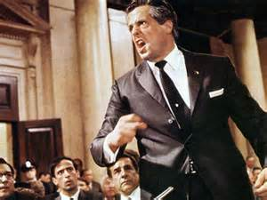
Some Demands
Registration of drugs in the countries
Lower prices
Clinical trials in the region
And more…

Slide 14
One Story
May 2013. Position: “EECA urges Gilead to not impede patient access to the drug "Atripla" in the EECA region”
October 2013. Open letter: “EECA CAB urges Gilead to take all measures necessary to ensure the emergency registration of Atripla and Stribild in the countries of Eastern Europe and
Central Asia”
February 2014. Reply: “Atripla is anticipated to be submitted to Russian health authority in May 2014. The price of Atripla in Estonia, Latvia and Lithuania will be reexamined and revised lower price will be offer to the appropriate authorities”.

Slide 15
Lessons learnt
Never overestimate the knowledge of pharma
Never underestimate the power of joint efforts
Public vs confidential
Try different approaches – sometimes you just never know what is going to work
It’s like throwing noodles into a wall with small holes. You never know which one will hit the hole ☺

Slide 16
The Website
http://eeca-cab.org/en/news/
The minutes
Open letters
Statements
Company contacts
Drug information
News
And more…

Slide 17
The Way Forward

