Slide 1
Hepatitis C Drug Pipeline
HCV WORLD CAB • FEBRUARY 2014
BANGKOK, THAILAND

Slide 2
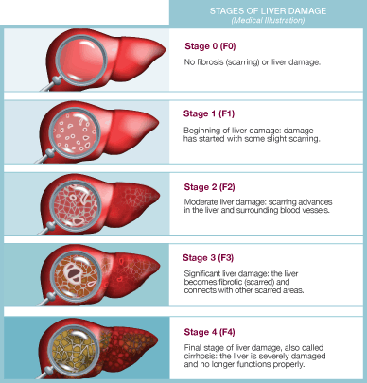
When to Treat HCV

Slide 3
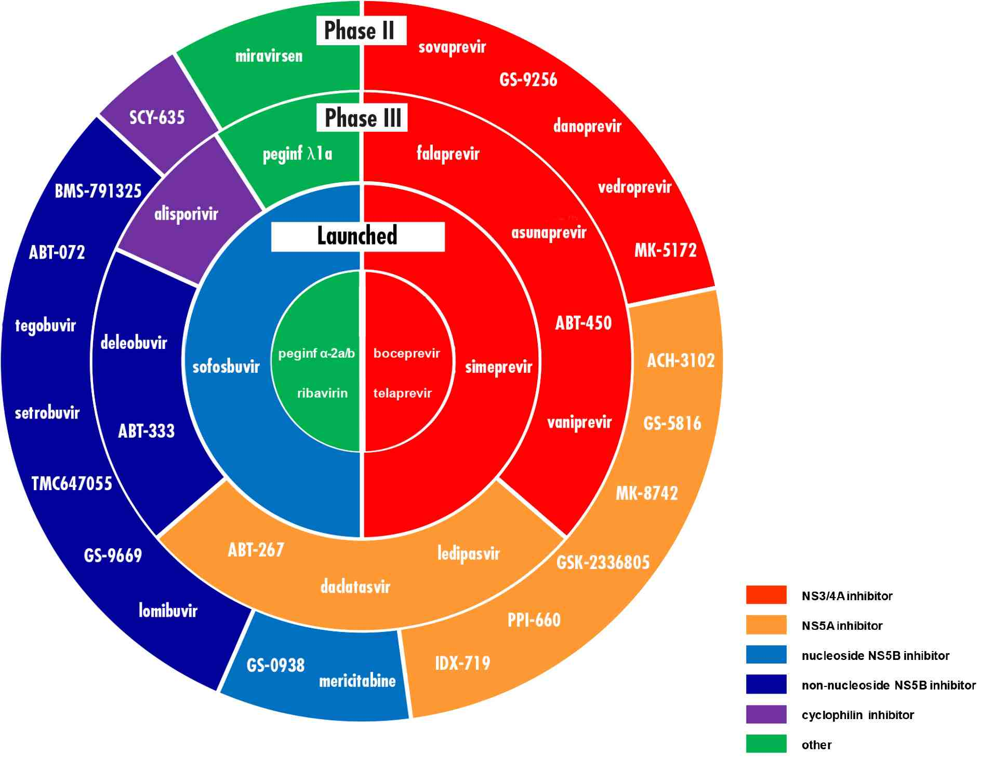
HCV Direct-Acting Antivirals (DAAs) in development

Slide 4
OVERVIEW
Know your epidemic: what matters
HCV treatment overview : now & in the near future
Strategies for scaling up

Slide 5
What is relevant to your epidemic?
Regulatory system
How long does/will it take?
HCV genotype (s)
Which are common in your area?
Access to treatment
Is there any, and to what?
Are there people who will need retreatment?
Other medications
(i.e. OST, ARVs, etc.)
Health care system
who is/will be treating
what is the capacity?

Slide 6
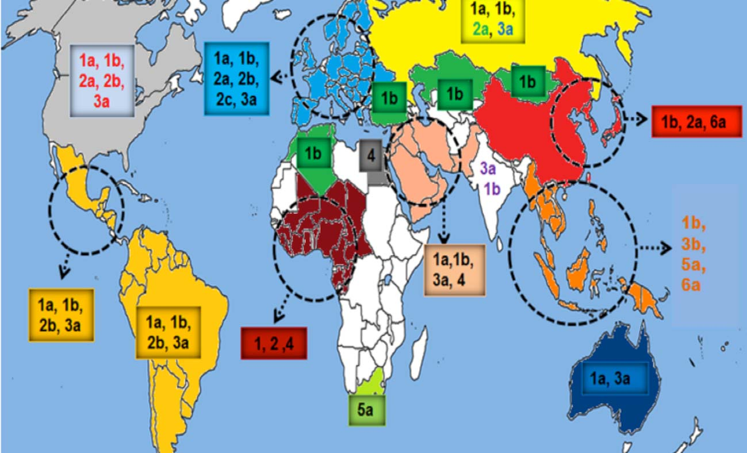
Distribution of HCV genotypes

Slide 7
ACTIVIST/COMMUNITY | MEDICAL PROVIDER | POLICYMAKER
AFFORDABLE & FEASIBLE: capacity to scale up; possibility for equitable/universal access | FEASIBLE: capacity to deliver treatment | AFFORDABLE
SAFE in cirrhosis, HIV/HCV, etc. | SAFE in cirrhosis, HIV/HCV, etc. | AFFORDABLE
EFFECTIVE (cure rate >80% for all), potent, high resistance barrier, option for second-line | EFFECTIVE (cure rate >80% for all), potent, high resistance barrier, option for second-line | AFFORDABLE
TOLERABLE; mild side effects | TOLERABLE; mild side effects | AFFORDABLE
APPLICABLE: pan-genotypic, manageable drug-drug interactions w/ (available) ARVs, OST, etc., | APPLICABLE: pan-genotypic, manageable drug-drug interactions w/ (available) ARVs, OST, etc. | AFFORDABLE
SIMPLE— fixed duration, less monitoring needed during & after TX, short-course | SIMPLE—fixed duration, less monitoring needed during & after TX , short-course | AFFORDABLE
CONVENIENT: once-daily, FDC or low pill burden, no food or cold chain/storage requirement | CONVENIENT: once-daily, FDC or low pill burden, no food or cold chain/ storage requirement | AFFORDABLE

Slide 8
HCV Treatment Overview
When is a cure really a cure (SVR)?
Pegylated interferon (PEG-IFN) and ribavirin (RBV)
Direct-acting antivirals (DAAs), by class and characteristics
HCV protease inhibitors
HCV non-nucleoside polymerase inhibitors
HCV nucleoside/tide polymerase inhibitors
HCV NS5A inhibitors

Slide 9
Sustained virologic response (SVR)
SVR: When hepatitis C becomes undetectable during treatment, and stays undetectable for at least 12 weeks afterwards—in other words, a cure
People who have an SVR are less likely to become die from liver disease or other causes
People with HIV/HCV who have an SVR are less likely to die from AIDS-related, liver-related and other causes

Slide 10
PEG-IFN & RBV
Non specific anti-viral/immune modulators:
pan-genotypic, limited DDIs, weekly
injection + pills 2 X/day
24 or 48 weeks, according to HCV genotype
Side effects can be unpleasant, debilitating, sometimes treatment-limiting
Less effective for people with cirrhosis
Less effective for people who are HIV+
(especially if they have genotype 1)

Slide 11
SVR, by HCV Genotype
GENOTYPE 1 ~50%
GENOTYPE 2 ~75%
GENOTYPE 3 ~60%
GENOTYPE 4 40% - 70%
GENOTYPE 5 49% - 60%
GENOTYPE 6 60% - 90%

Slide 12
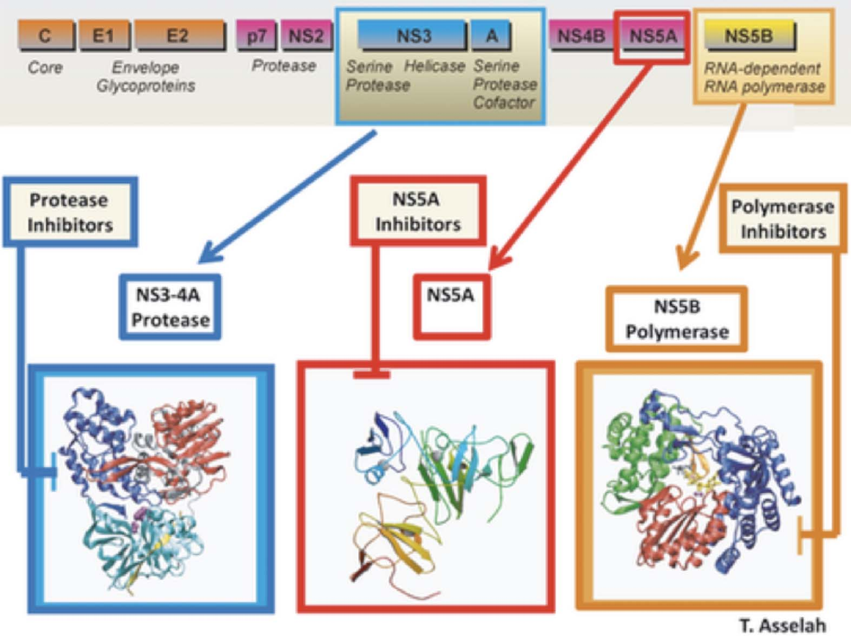
Source: Asselah T, Marcellin P. Liver International, 2013

Slide 13
HCV Protease Inhibitors
active against some genotypes ( usually 1 & 4)
low barrier to resistance
tend to have DDIs with ARVs and other
commonly-used drugs (OST is usually OK)
used with PEG-IFN/RBV, or RBV, or + other DAAs
newer drugs are once-daily
first generation (BOC and TPV) are complicated, toxic—likely to become cheap

Slide 14
HCV Non-Nucleoside Polymerase Inhibitors
active against genotype 1
low barrier to resistance
used with 2 other DAAs
no information on DDIs
hard to know about side effects, because they are used with other drugs
most are twice-daily

Slide 15
HCV Nucleoside/Tide Polymerase Inhibitors
pan-genotypic
high resistance barrier
used with PEG-IFN and RBV, RBV alone, and other DAAs
few DDIs
few side effects (but hard to tell, since used with other drugs)
once-daily

Slide 16
HCV NS5A Inhibitors
some are pan-genotypic, others not so much
low resistance barrier
used with other DAAs, with or without RBV
Some DDIs
few side effects (but hard to tell, since used in combination with other drugs)
once-daily

Slide 17
HCV Treatment, by genotype
Genotypes 1, 2, 3, 4, 5, & 6
Treatment options for each
Cure rates, in each

Slide 18
SVR in HCV Genotype 1
P/R P/R + HCV PI P/R + SOF DAAs
48 W 24-48 W 12 W 8-12 W

Slide 19
G1: Which Regimens Can do This?
PEG-IFN/ RBV + DAA
+ SMV (protease inhibitor) 80%
24 or 48 weeks
+ SOF (nucleotide) 90%
12 weeks
DAAs, with and without RBV
SOF + RBV 78% 24 weeks
SOF+ SMV ~95% 12 weeks

Slide 20
G1: Which Regimens Can do This?
In the pipeline for 2014
SOF + LPV (NS5A) >95% 8 to 12 weeks
SOF + DCV (NS5A) 100% 12 weeks
AbbVie (ABT 450/r (BOOSTED PI) + ABT-267 (NS5A) + ABT 333 (NNPI) + RBV 12 weeks ~95%

Slide 21
PEG-IFN/RBV SOF/ RBV SOF /RBV SOF/ DCV
24 W 12 W HIV+ 12 W ± RBV 24 W
SVR, Genotype 2
Gane, et al; EASL 2013;
Sulkowski, et al; AASLD 2013; NEJM 2014

Slide 22
PEG/RBV SOF/RBV SOF/RBV SOF/DCV ± RBV 24 W 12 W 24W 24 W
SVR, Genotype 3
Gane et al, EASL 2013;
Sulkowski, et al; NEJM 2014
Zeuzem et al; AASLD 2012

Slide 23
SVR, Genotype 4 (in 55 people)
PEG-IFN/RBV + SOF 96%
12 weeks
SOF+ RBV 79%
12 weeks
SOF+ RBV 100%
24 weeks
Some HCV protease inhibitors also work in G4, but no results yet

Slide 24
And then there were 12: HCV Genotypes 5 and 6
G5: PEG-IFN/RBV + SOF: 100%
12 weeks
G6: PEG-IFN/RBV + SOF: 100%
12 or 24 weeks

Slide 25
Which medicines? Now or Later?
PEG-IFN?
RBV?
SOFOSBUVIR?
DACLATASVIR?
What about diagnostics?
Some regimens need more testing before and during treatment
What about capacity?
How soon will “the future” be here ?

Slide 26
A PEG to Stand On?
What are the best approaches for HCV treatment scale up?
Fighting for PEG-IFN (patent expiry, biosimilars)—can do this NOW, save lives, lay groundwork for larger implementation
Picking a single, simple regimen—makes it easier/simpler to treat, less tests are needed but there’s no competition, prices stay high
Bargain hunting?
Other options – Merck, AbbVie, BMS will need to compete---could get a great NS5A to mix, with what?

Slide 27
Sofosbuvir: Value
Currently the only DAA suitable for use as a therapeutic backbone: safe, effective, tolerable, manageable, convenient
Unique resistance profile; potential for second-line with other DAAs?
Development of other nucleotides unlikely, due to horrible toxicity or lack of efficacy

Slide 28
Sofosbuvir: Price
In the US, Gilead is charging $1,000 per day for sofosbuvir.
If only 500,000 people in the U.S. —less than a quarter of those with chronic HCV—are treated with sofosbuvir, sales would reach US $45 billion dollars.
If they cut the cost by 50%, sales would reach $22.5 billion dollars

Slide 29
COST: one perspective ….
“The cost to manufacture one 34-g regimen would be approximately $1400, excluding the costs of formulation, encapsulation, and marketing.”
Hagan, et al; Trends in Microbiology, Dec 2013
Raymond F. Schinazi, co-founder of Pharmasset, who
made $440 million when it sold to Gilead

Slide 30
Sofosbuvir: Cost (production)
From Hill and colleagues, based on:
total daily dose (for 12 weeks)
chemical structure
molecular weight
complexity of synthesis,
Compared to production cost and
complexity of antiretrovirals with
a similar structure
$68 to $138
Hill, et al. CID, 2014

